Slide 1
Generative Models

Slide 2
Logistics
Project status videos: next Thursday. Instructions on website.
Next reading/video/discussion will be on Bias and Fairness
Next:
Sequence modeling redux (translation, Transformers architecture, etc.)
Other human-centered concerns (transparency / interpretability)
Reinforcement Learning
Breadth or depth (in what topics?)

Slide 3
Links to have open
GANSpace
GAN Lab
GANpaint
https://j.mp/cam2head

Slide 4
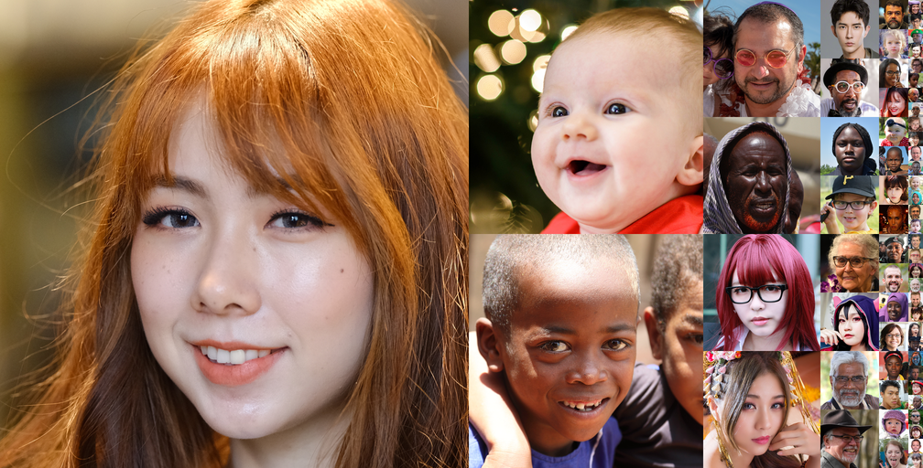
What’s the difference?

Slide 5
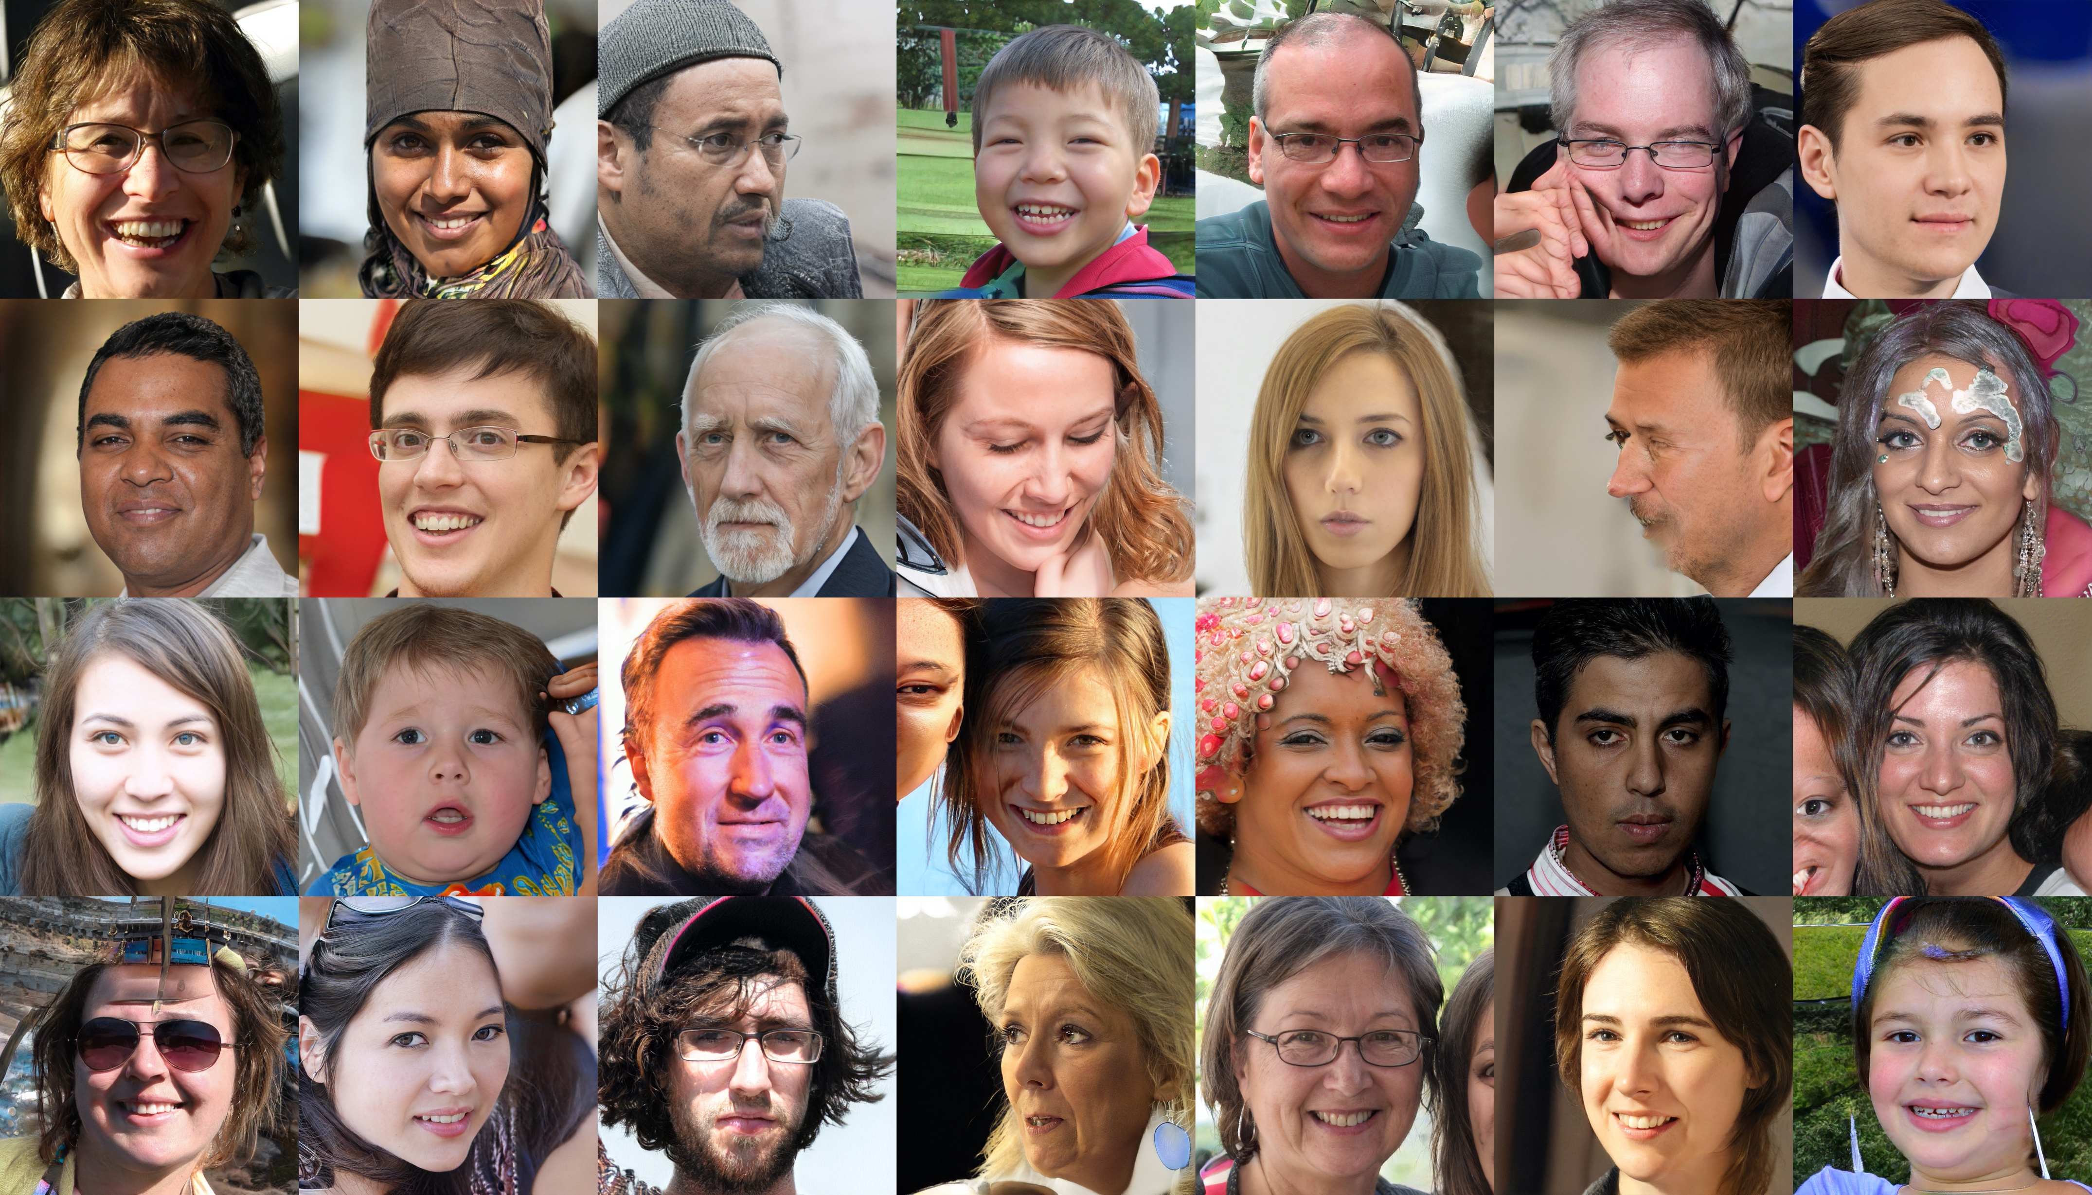

Slide 6
Which was real?
First slide: FFHQ dataset (https://github.com/NVlabs/ffhq-dataset)
Second slide: mid-training snapshot of fine-tuning StyleGAN2

Slide 7
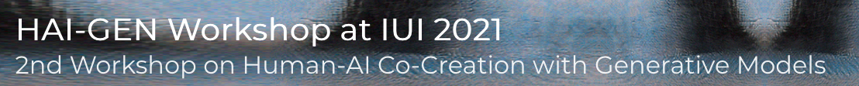
Today: Generation
One approach: LMs.
Today: alternatives
Applications examples: HAI-GEN workshop
Platform game level generation
3D animal shapes
Controlling an instrument with your voice g.co/tonetransfer
Generating documentation for Jupyter notebooks

Slide 8
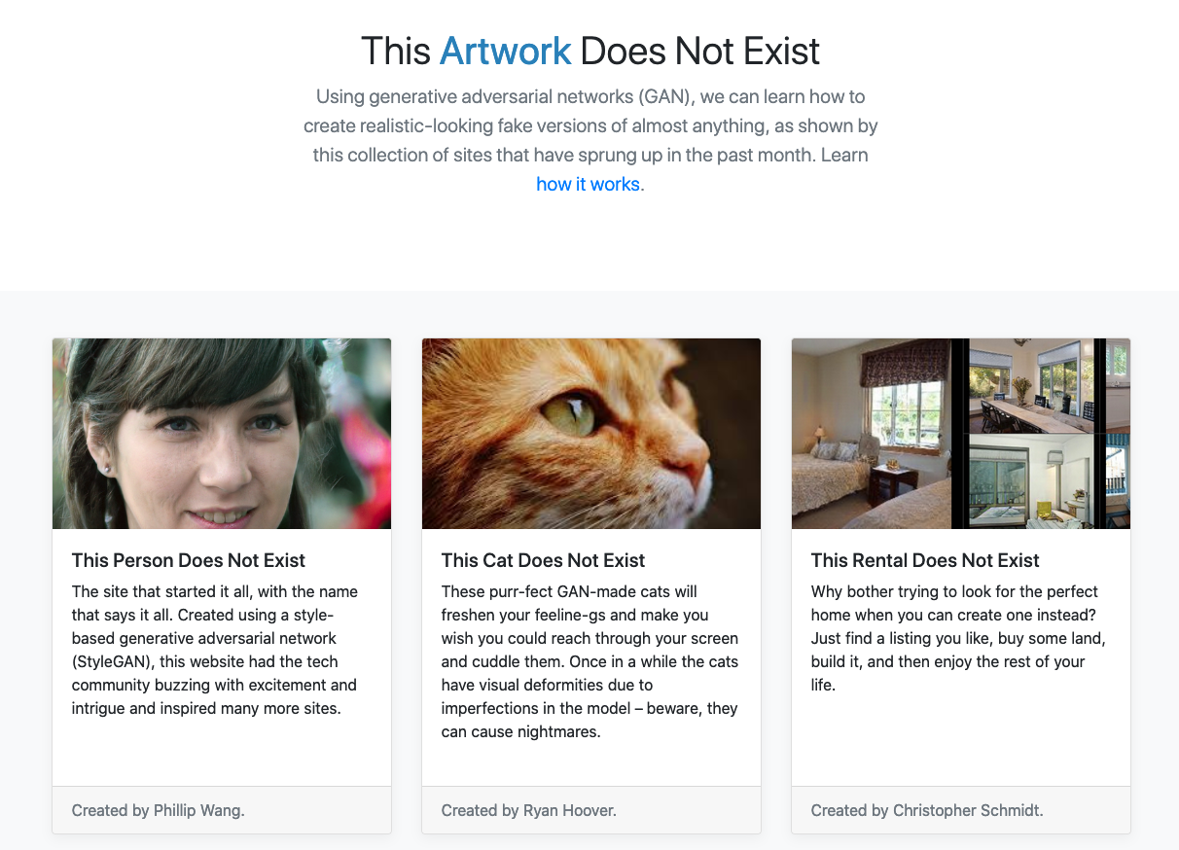
https://thisxdoesnotexist.com/

Slide 9
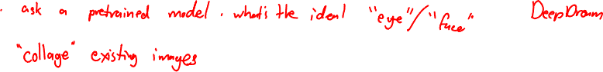
How might an AI generate an image?

Slide 10
Goal: Why can generative models work?
How? Look on YouTube
What about the world makes this work?

Slide 11
Main Ideas Today
We can give probabilities to images / sounds / videos / …
Natural images occupy a tiny portion of the space of all images.
We can map that small portion to a latent space.
Generative models consist of some combination of:
generator / decoder: latent space -> full image
encoder: image -> latent space
discriminator: image -> probability

Slide 12
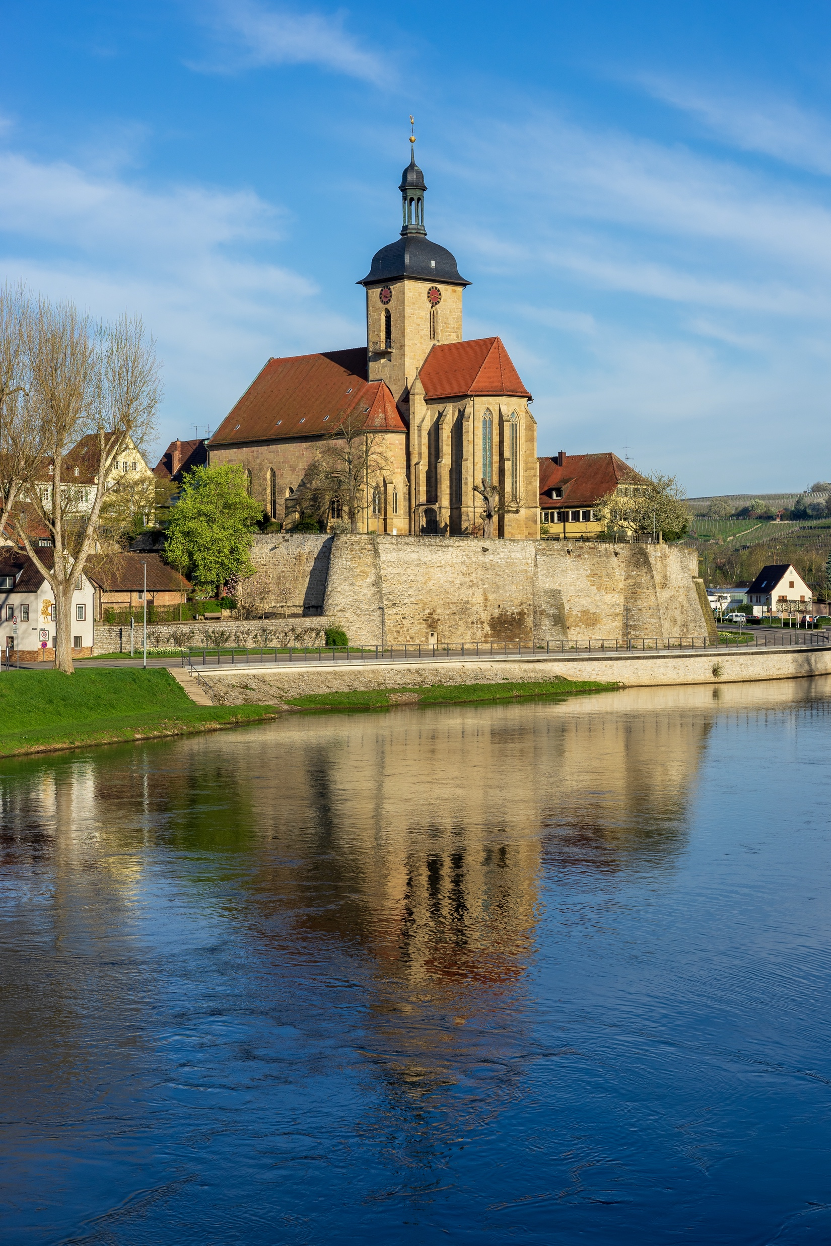
How likely is this image?
https://commons.wikimedia.org/wiki/File:Lauffen_a.N._-_die_Regiswindiskirche_auf_ihrem_Felsen_%C3%BCber_dem_Neckar_2.jpg

Slide 13
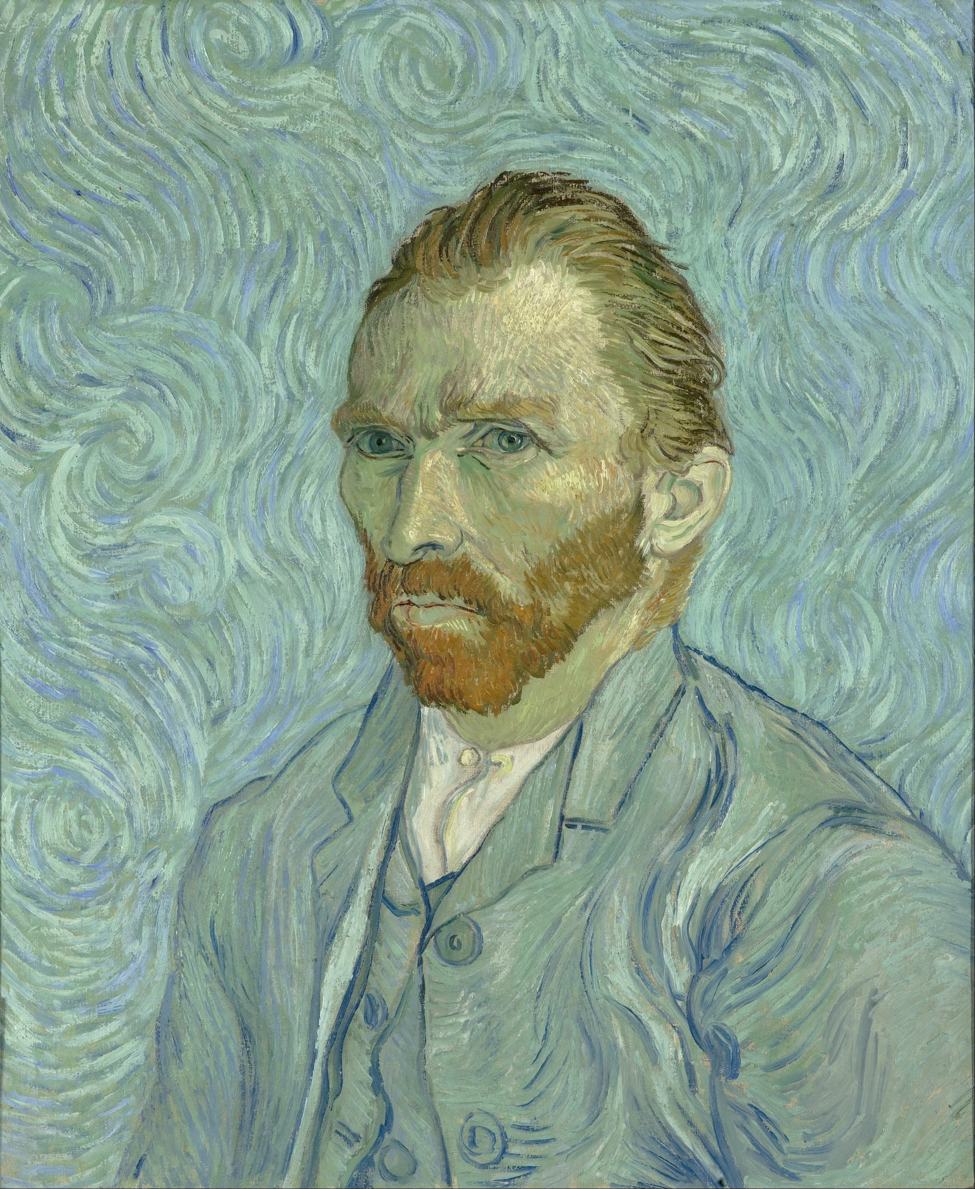
How likely is this image?
https://commons.wikimedia.org/wiki/File:Vincent_van_Gogh_-_Self-Portrait_-_Google_Art_Project.jpg

Slide 14
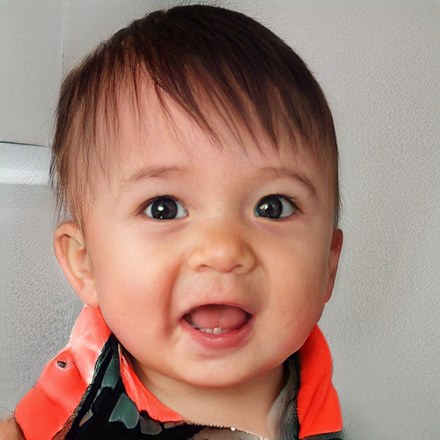
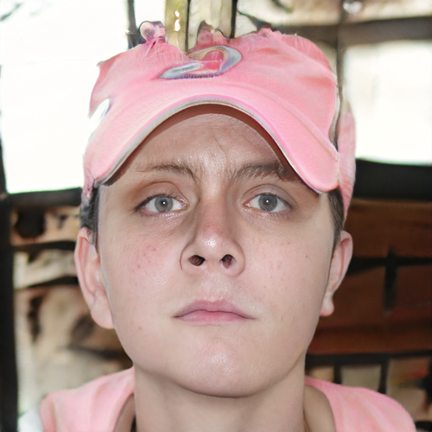
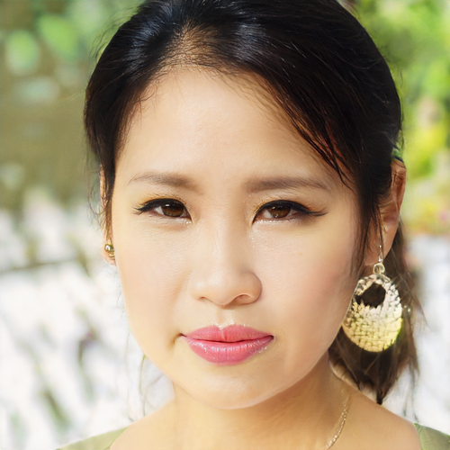
How likely is this image?
Notes:
StyleGAN2 generations… with me playing with GANSpace controls

Slide 15
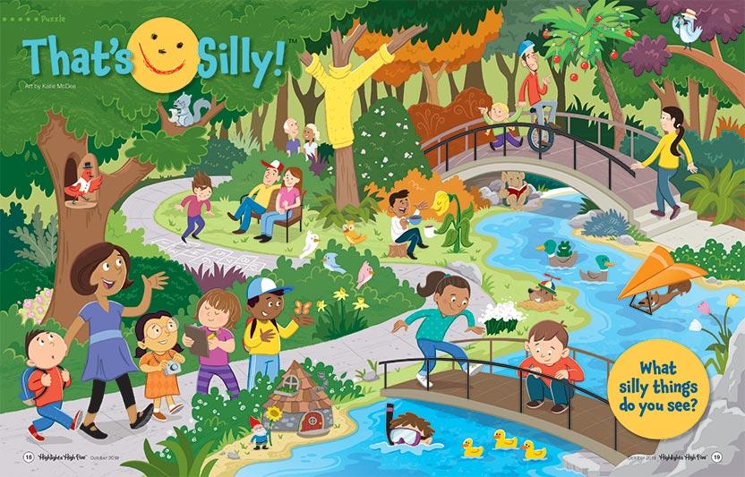
How likely is this image?
https://www.highlights.com/parents/articles/inside-high-five-october-2018-thats-silly

Slide 16

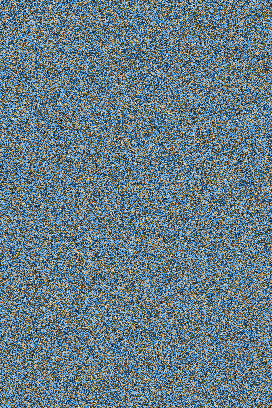
How likely is this image?
Notes:
The image on the right is exactly shuffled of the one on the left.

Slide 17
We can give a probability to an image
Often: probability that the image is real
Occasionally: probability that a given image is this one

Slide 18
Main Ideas Today
We can give probabilities to images / sounds / videos / …
Natural images occupy a tiny portion of the space of all images.
We can map that small portion to a latent space.
Generative models consist of some combination of:
generator / decoder: latent space -> full image
encoder: image -> latent space
discriminator: image -> probability

Slide 19
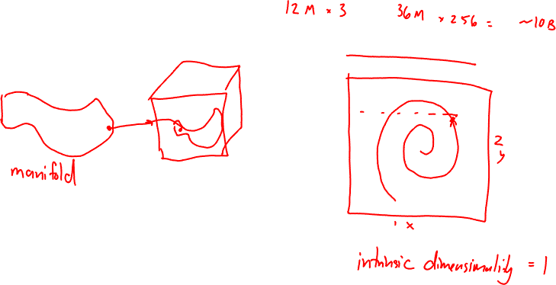
Natural images are a small subset of all possible images

Slide 20
Core idea: embed images in latent space
Demo: https://observablehq.com/@stwind/latent-flowers-ganden

Slide 21
Main Ideas Today
We can give probabilities to images / sounds / videos / …
Natural images occupy a tiny portion of the space of all images.
We can map that small portion to a latent space.
Generative models consist of some combination of:
generator / decoder: latent space -> full image
encoder: image -> latent space
discriminator: image -> probability

Slide 22
Main Ideas Today
We can give probabilities to images / sounds / videos / …
Natural images occupy a tiny portion of the space of all images.
We can map that small portion to a latent space.
Generative models consist of some combination of:
generator / decoder: latent space -> full image
encoder: image -> latent space
discriminator: image -> probability

Slide 23
Examples of Generative Models

Slide 24
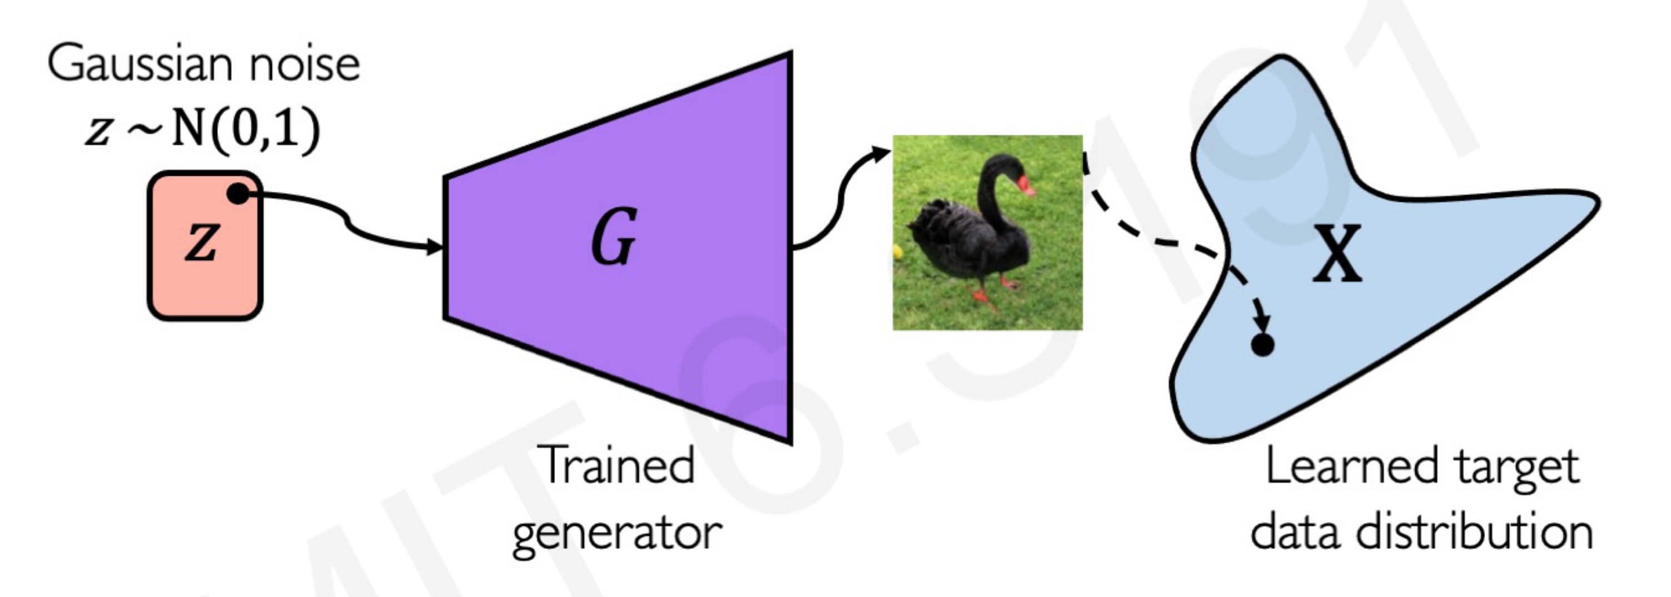
Generative Adversarial Network
http://introtodeeplearning.com/slides/6S191_MIT_DeepLearning_L4.pdf

Slide 25
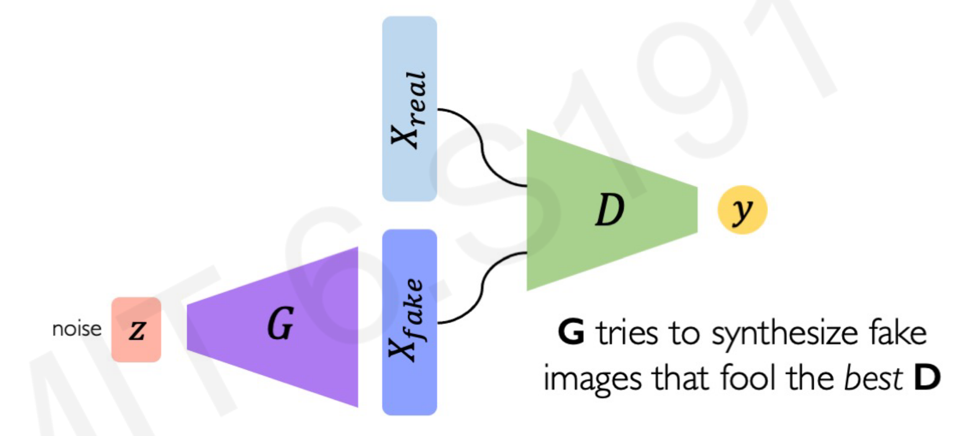
Generative Adversarial Network
Try it at GANLab

Slide 26
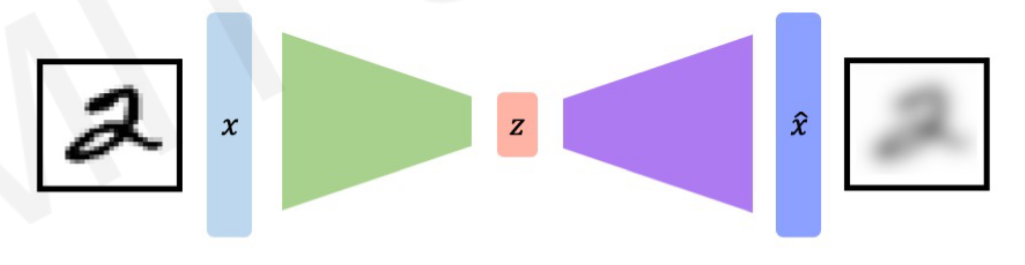
Autoencoder
Reconstruction Loss: output minus input
Encoder E
Decoder D
http://introtodeeplearning.com/slides/6S191_MIT_DeepLearning_L4.pdf

Slide 27
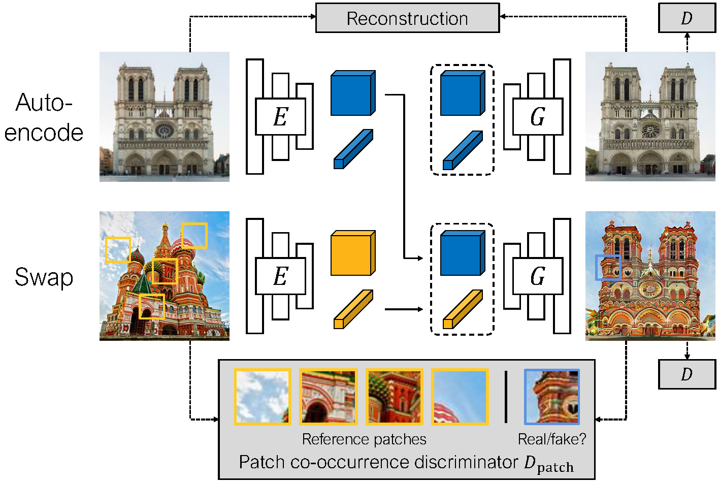
Swapping Autoencoder
https://taesung.me/SwappingAutoencoder/

Slide 28
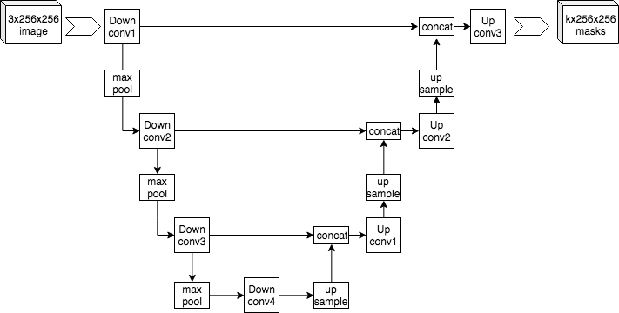
U-Net
https://commons.wikimedia.org/wiki/File:Example_architecture_of_U-Net_for_producing_k_256-by-256_image_masks_for_a_256-by-256_RGB_image.png

Slide 29
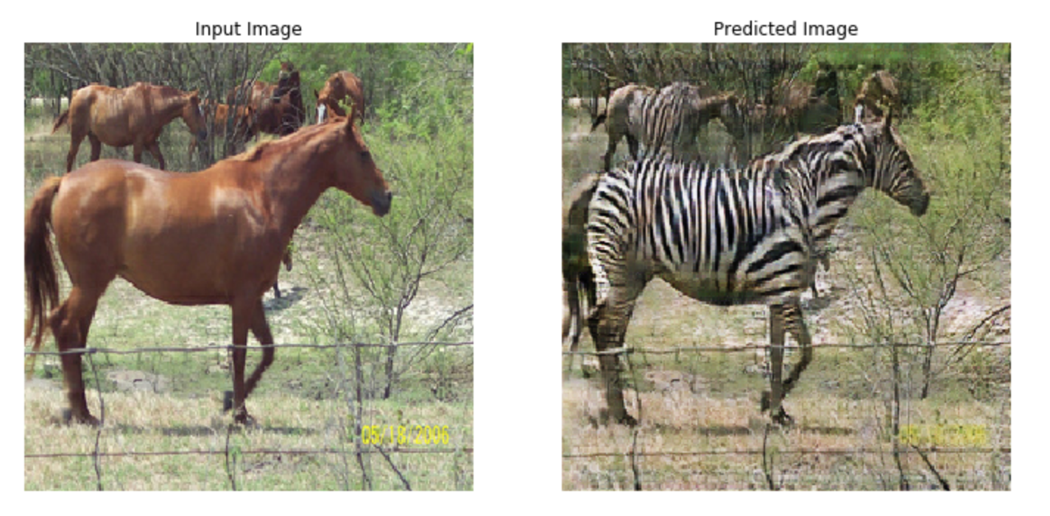
CycleGAN (image <-> image)
https://www.tensorflow.org/tutorials/generative/cyclegan

Slide 30
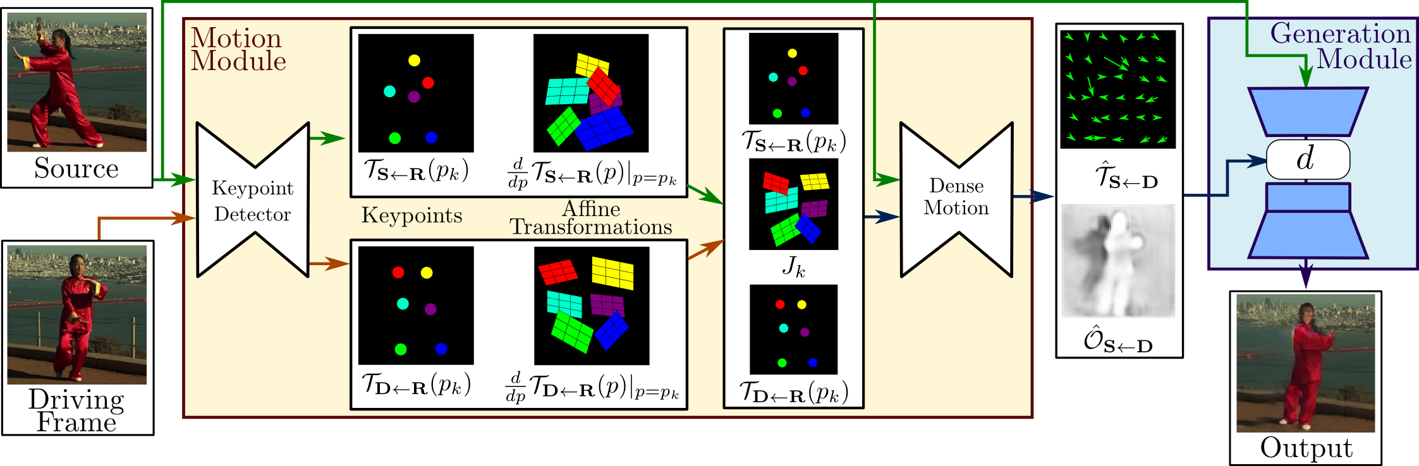
You don’t need all this for a simple deepfake
https://aliaksandrsiarohin.github.io/first-order-model-website/
Demo: https://github.com/eyaler/avatars4all

Slide 31
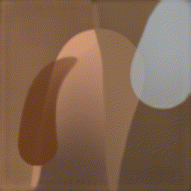
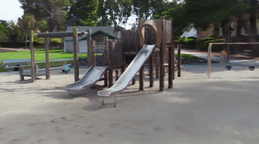
Many other creative approaches
Learning to draw an image stroke-by-stroke
PaintBot / https://arxiv.org/abs/1904.02201
Model-based RL: https://arxiv.org/abs/1903.04411
Interactive image editing (GANPaint)
Controls (e.g., GANSpace)
Use a sequence model (Transformers)
https://compvis.github.io/taming-transformers/
Neural Rendering (NeRF)
https://github.com/Kai-46/nerfplusplus
https://github.com/yenchenlin/awesome-NeRF

Slide 32
Applications
Video conferencing
Background segmentation (e.g., virtual backgrounds)
regenerate the face on the client side (e.g., NVIDIA Maxine)
Sim2real: train robots in simulations that perform well in real world
Super-resolution, image/sound restoration
Inpainting: remove distracting objects (now in Photoshop)
Anomaly detection (e.g., tumor detection)
Causal inference

Slide 33
Practical tips
Use pre-trained models
Use battle-tested code (e.g., https://github.com/NVlabs/stylegan2-ada-pytorch)
Start with already-running code and tweak it
Consider other approaches besides GANs:
VAEs like https://github.com/openai/dall-e or Taming Transformers
https://github.com/lucidrains/DALLE-pytorch
CPPNs

Slide 34
Perspectives and Ethical Considerations

Slide 35
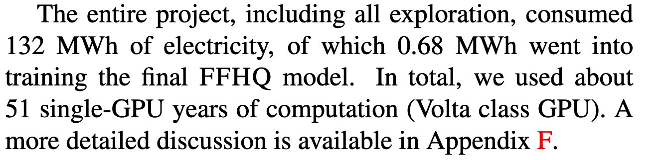
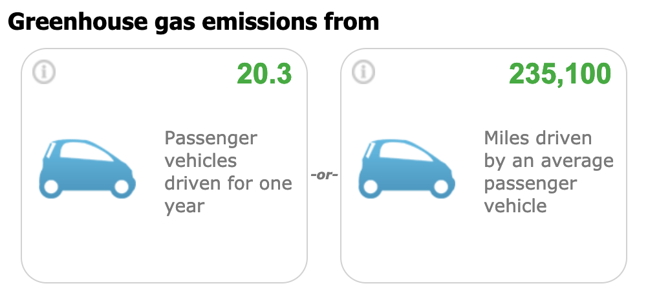
StyleGAN2’s Energy Cost
https://arxiv.org/abs/1912.04958
https://www.epa.gov/energy/greenhouse-gas-equivalencies-calculator

Slide 36
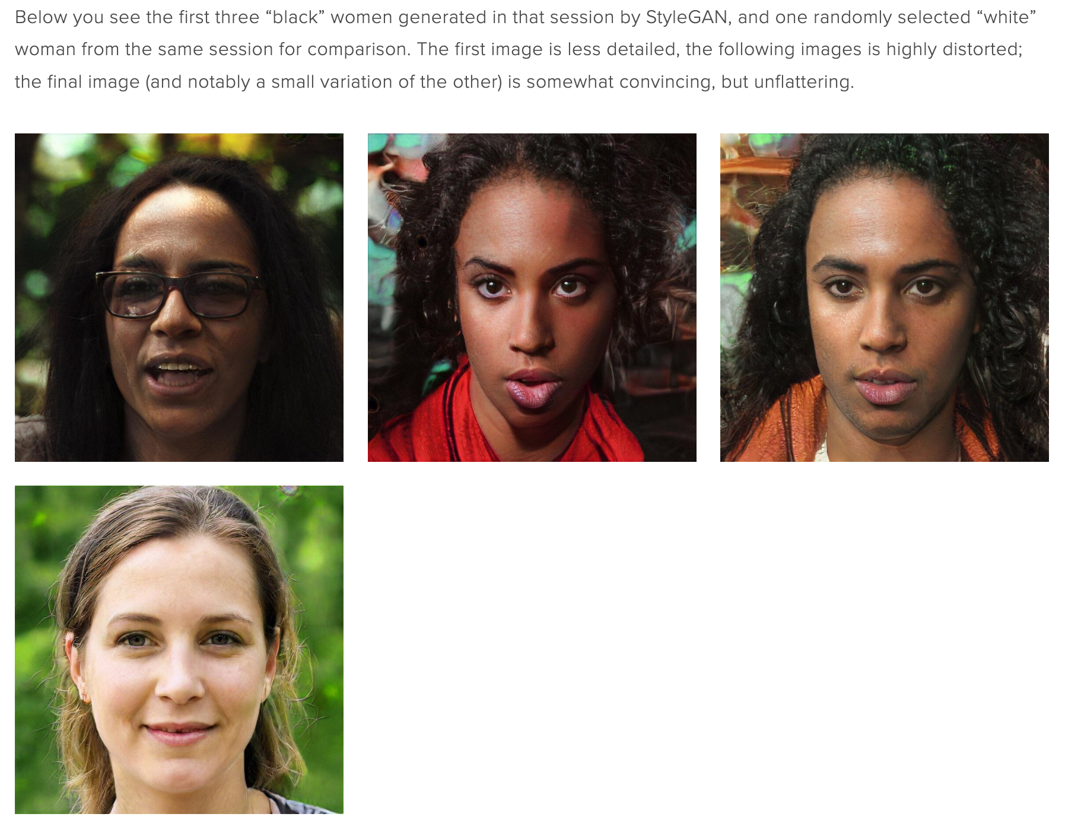
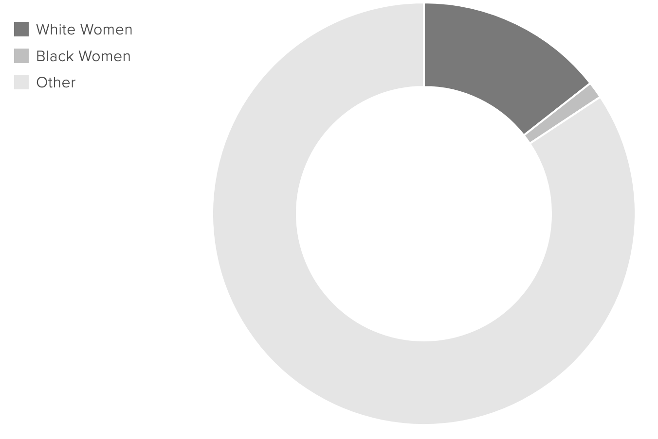
https://www.intersectsy.com/intersectsy/2019/10/3/what-i-learned-about-bias-from-the-first-ai-generated-faces-on-wikimedia-commons

Slide 37
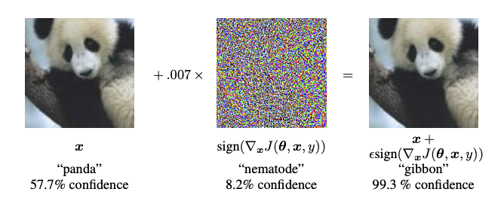
Adversarial Examples
Generating an image to fool a classifier
https://www.tensorflow.org/tutorials/generative/adversarial_fgsm

Slide 38
Who owns the image? Who owns the model?

Slide 39
Other questions?

